Slide 1



FINAL PROJECT
NAME:GOKADA SRAVYA
ROLL.NO:22Q71A0554
MAIL: sravyagokada@gmail.com
DOMAIN:CYBER SECURITY
CLG: AVANTHI institute of engineering and technology
PROJECT: Hiding text from image using steganography
VISKHAPATNAM,ANDHRA PADESH

Slide 2

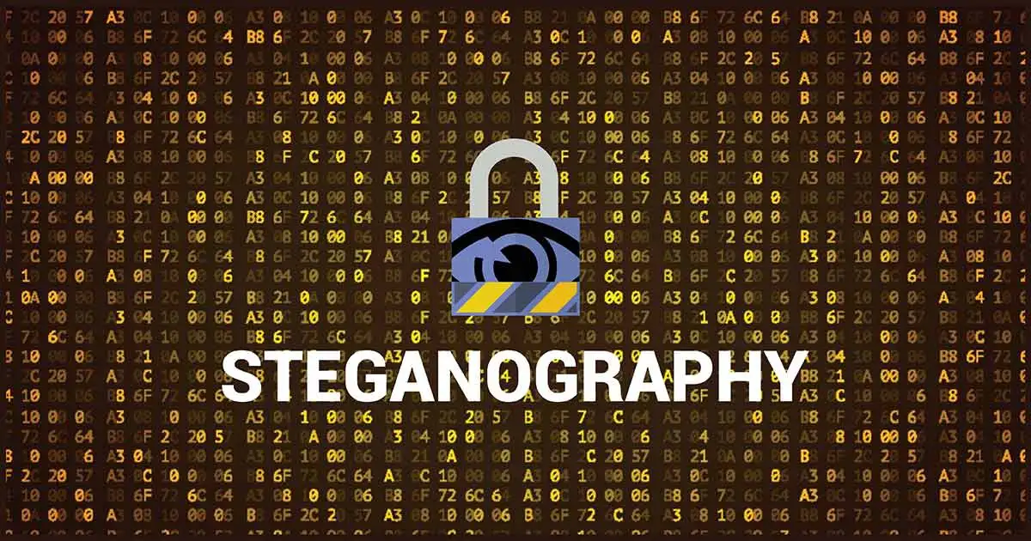
HIDING A TEXT INSIDE A IMAGE USING Steganography
G.SRAVYA

Slide 3

AGENDA
Introduction
Problem Statement
Project Overview
End Users
Solution and Value Proposition
Modelling
Results
Conclusion

Slide 4
PROBLEM STATEMENT
Problem statement:
>Her we can send message secretly to the destination.
>Using steganography ,information can be hidden in carriers such as
images,text-files,audios,vedio.

Slide 5
PROJECT OVERVIEW
Objective:
1.In my project I primarily concentrated on the data security issues when the sending the data over the network using steganography techniques
2. The main objectives of the project are requirement of this steganography system is that the Hidder message carried by the stego- media should not be sensible to human beings.
3. The Other Goal of steganography is to avoid drawing suspicion to the existence of a hidden message
.SCOPE:
--The scope of the project is to limit unauthorised access and provide better
security during messages transmission to meet the requirements ,i used a
simple and basic approach of steganography.
--In this project the proposed approach finds the suit to the algorithm for the
embedding the data in an image using stagnography which provides the better
Security pattern versus to a network.

Slide 6
WHO ARE THE END USERS
This has various end-users across different fields. Some are:
Military and Defense: To securely transmit classified information over public channels.
2. Intelligence Agencies: For covert communication and espionage.
3. Cybersecurity Professionals: To hide sensitive data or malware detection signatures.
4. Digital Forensics Investigators: To uncover hidden evidence in images.
5. Privacy-Conscious Individuals: To protect personal information or communication.
6. Artists and Designers: To create visually striking and thought-provoking artworks.
7. Researchers and Scientists: To conceal sensitive research data or results.

Slide 7
SOLUTION AND ITS PROPOSITIONS
~~ Least Significant Bit (LSB) in steganography:
"In steganography, the Least Significant Bit (LSB) is the last bit in each byte of an image's pixel value. By replacing the LSB with secret data, the image remains visually unchanged, yet conceals the hidden information. This technique exploits the human eye's limitations, as small changes in pixel values are imperceptible, allowing for covert data transmission."

Slide 8
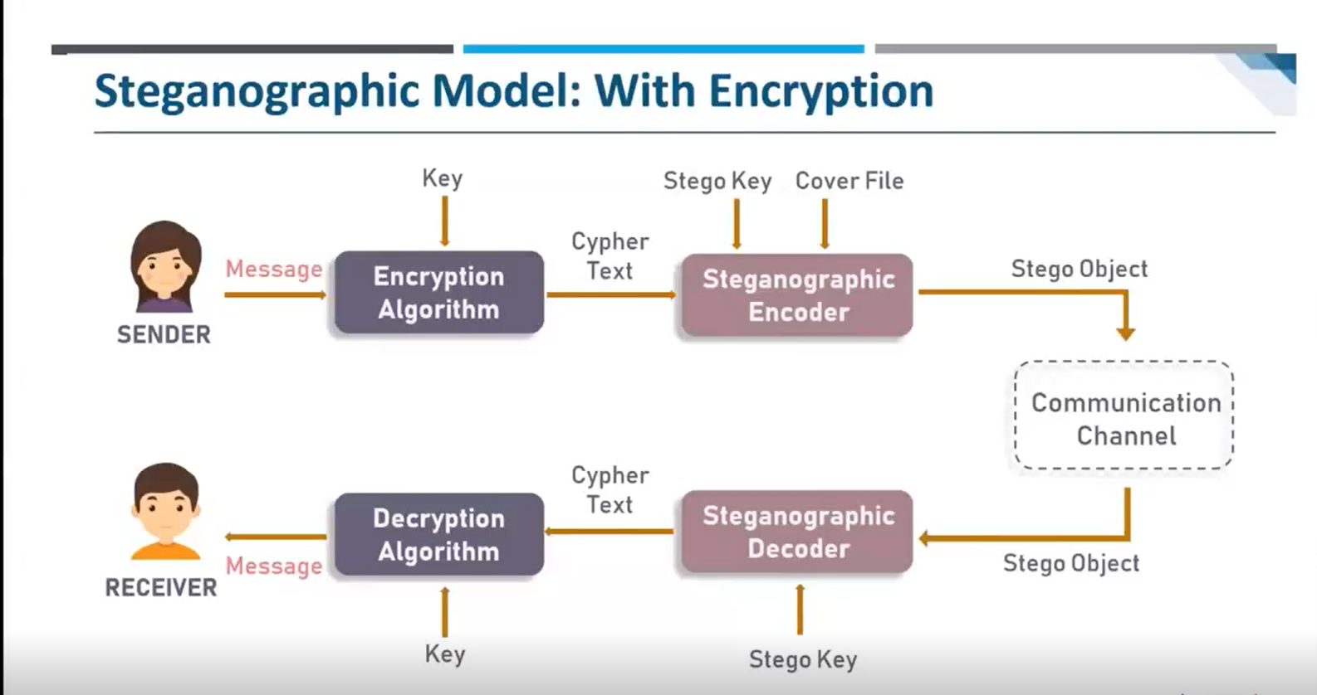
MODELLING
,
G.SRAVYA

Slide 9
MODELLING
Step 1: Importing some libraries like cv2 and os for accessing relevant concept into code.
Step 2: After converting the text into their ascii values then that ascii values are stored in variable.
Step 3: Read the image from it’s path and hiding the image using XOR operation , RGB
mechanism
Step 4: A secret is created to avoid unauthorized users.
Step 5: To unhide the image user wants to enter the secret key.
Step 6: Finally, user can able to see the secret message.

Slide 10
RESULTS
Image: A image with a complex pattern.
Hidden Text: "This image contains a secret message“
Stegano-Image: The image with the hidden text encoded in the pattern
Extraction Result: Successful extraction of the
hidden message.
G.SRAVYA

Slide 11

RESULTS
Original image
Encrypted image
we can see there is no difference in both the normal and encrypted images
ginal image
Above image is normal image.
We can choose the image on which we want to do the encryption
G.SRAVYA

Slide 12
Github Link:
https://github.com/Sravya1yadav/cyber-security.git
MAIL:
sravyagokada@gmail.com
G.SRAVYA

Slide 13
THANKU YOU
G.SRAVYA

